Slide 1
Scene Recognition using Spatial Pyramids of Strong Features and Poselets
Shiry Ginosar
Valkyrie Savage
Slide credits:
S. Lazebnik
Lubomir Bourdev

Slide 2
Define: Scene A place within which a human can act, or a place where a human could navigate to.
J. Xiao, J. Hays, K. Ehinger, A. Oliva, and A. Torralba. SUN Database. CVPR 2010.

Slide 3
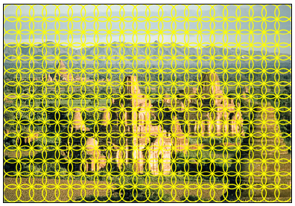
Bag of Features
Weak Features
Strong Features (SIFT)

Slide 4
Beyond Bags of (Strong) Features
Sky
Buildings
Mountains
S. Lazebnik, C. Schmid, and J. Ponce. Beyond bags of features(CVPR), 2006.

Slide 5
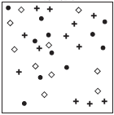
Beyond Bags of (Strong) Features
1. Construct visual word dictionary
S. Lazebnik, C. Schmid, and J. Ponce. Beyond bags of features(CVPR), 2006.

Slide 6
Beyond Bags of (Strong) Features
2. Build spatial pyramids of histograms
S. Lazebnik, C. Schmid, and J. Ponce. Beyond bags of features(CVPR), 2006.

Slide 7
Beyond Bags of (Strong) Features
2. Build spatial pyramids of histograms
S. Lazebnik, C. Schmid, and J. Ponce. Beyond bags of features(CVPR), 2006.

Slide 8
Beyond Bags of (Strong) Features
3. Create histogram intersection kernels
S. Lazebnik, C. Schmid, and J. Ponce. Beyond bags of features(CVPR), 2006.

Slide 9
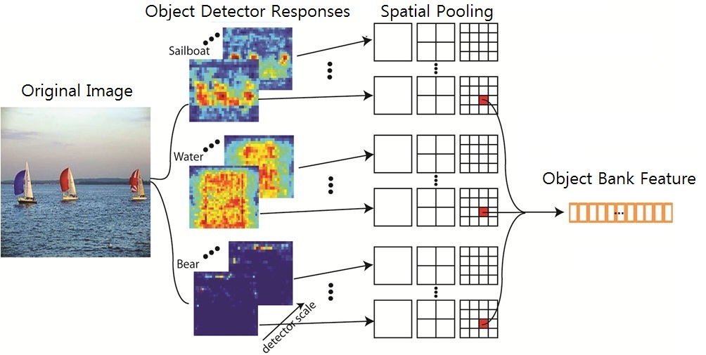
Pyramids of Super-Strong Features
L.-J. Li*, H. Su*, E.P. Xing and L. Fei-Fei. Object Bank. (NIPS). 2010.

Slide 10
Define: Scene A place within which a human can act, or a place where a human could navigate to.
J. Xiao, J. Hays, K. Ehinger, A. Oliva, and A. Torralba. SUN Database. CVPR 2010.

Slide 11
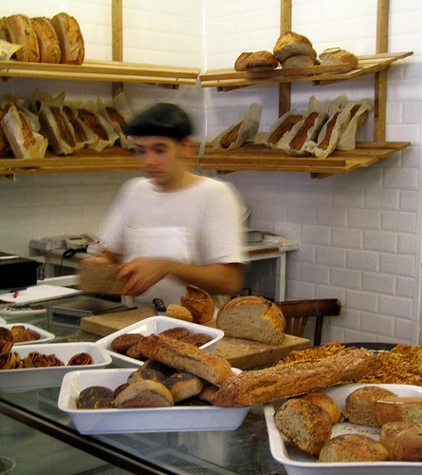
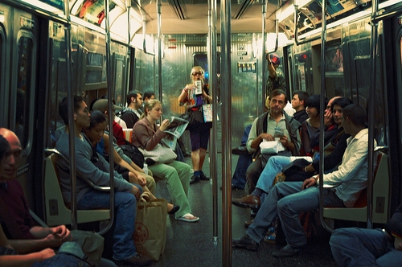
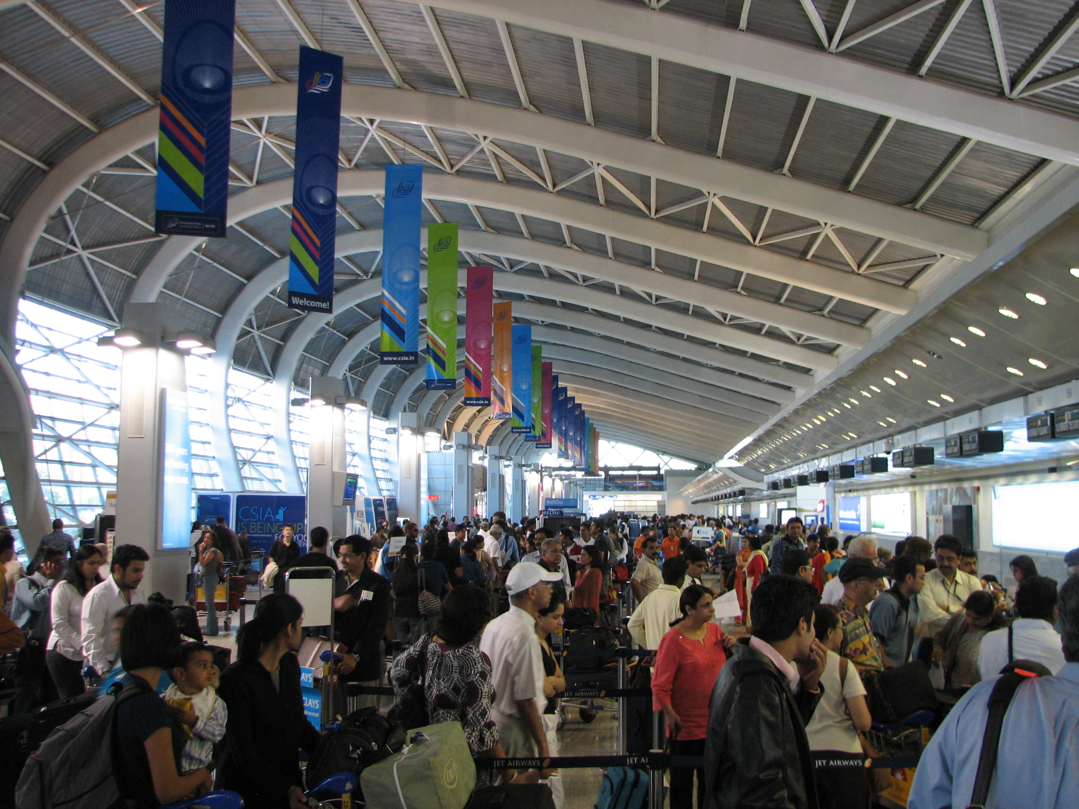
Humans in Scenes

Slide 12
Our Experiments
Notes:
Work done in collaboration with: Jeffrey Heer2, Maneesh Agrawala1
1University of California, Berkeley 2Stanford University

Slide 13
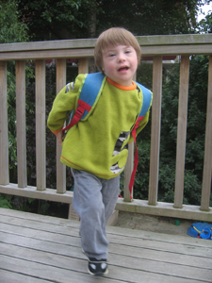
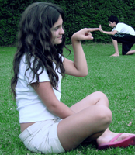
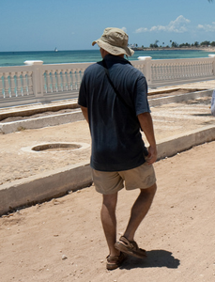

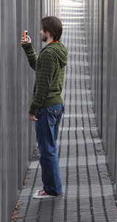
Detect number of people and their actions using poselets
Lubomir Bourdev, Jitendra Malik, Poselets. ICCV 2009.

Slide 14
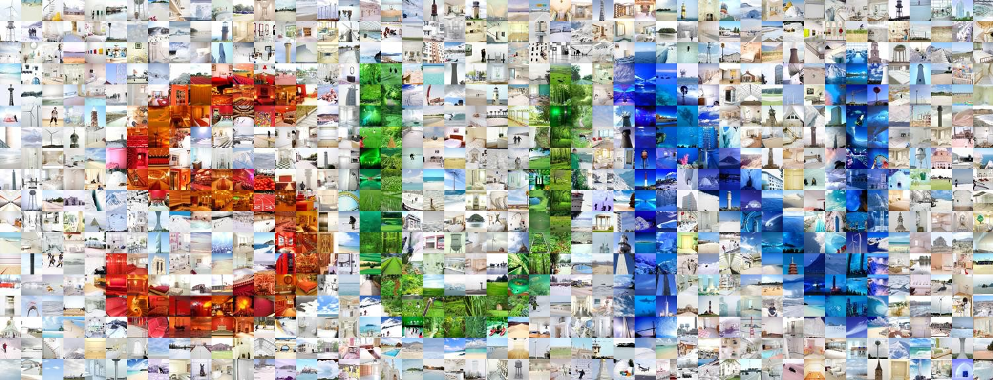
SUN dataset 899 categories and 130,519 images.
In practice, 15 top-people scene categories with 50 training and 50-testing examples each. (Plan to re-run with the full data).
J. Xiao, J. Hays, K. Ehinger, A. Oliva, and A. Torralba. SUN Database. CVPR 2010.

Slide 15
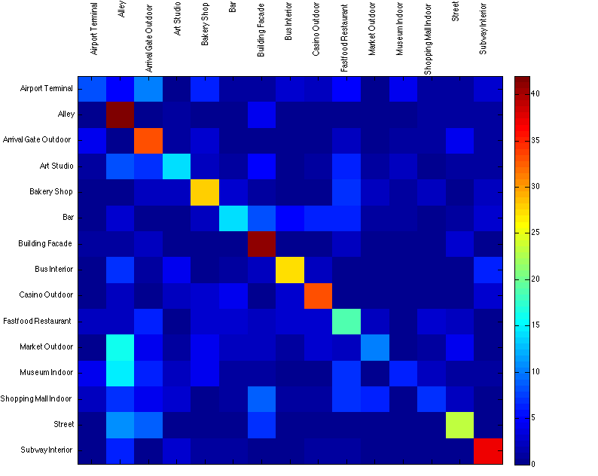
Baseline: Spatial Pyramids of Strong Features
Accuracy: 0.456

Slide 16
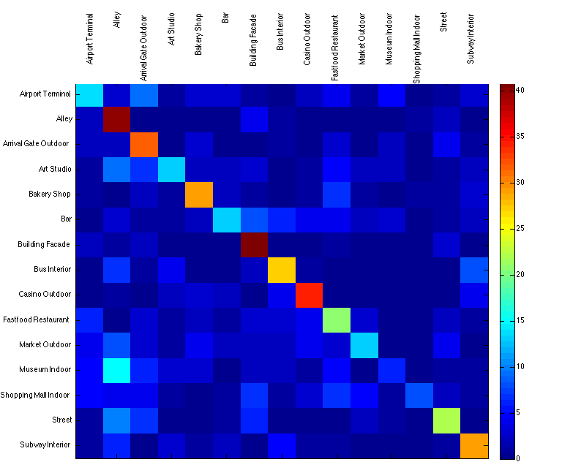
Add the number of people
Accuracy: 0.456

Slide 17
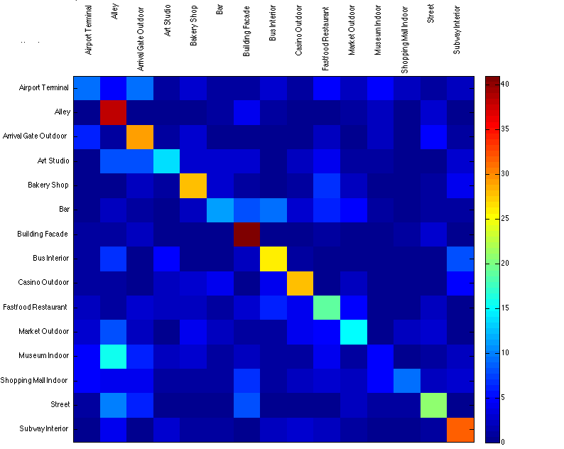
Spatial pyramid of strong features and people
Accuracy: 0.433

Slide 18
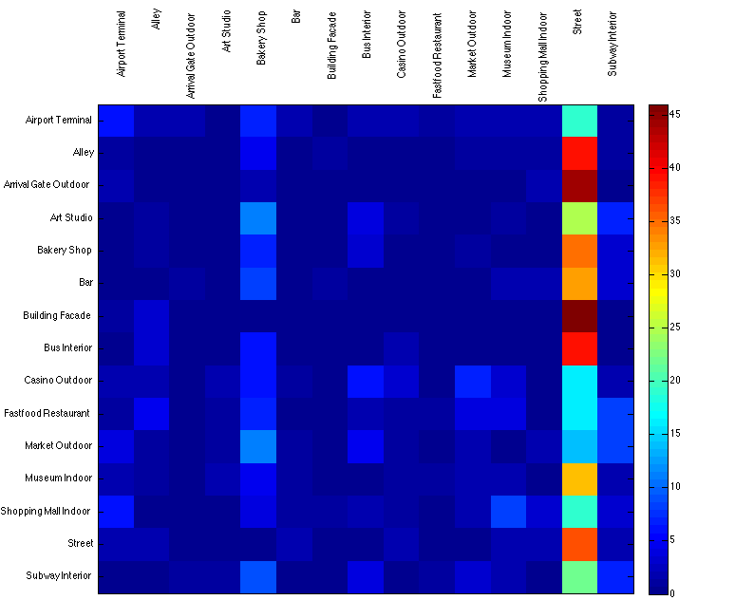
Ablation: Pyramids of people histograms
Accuracy: 0.089

Slide 19
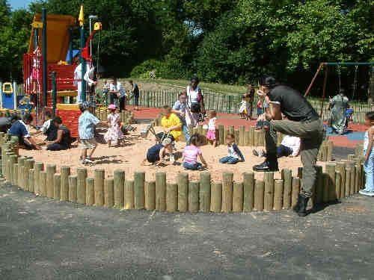
Possible problems and improvements

